Slide 1
Spirit Level
Mission 11

Slide 2

Pre-Mission Preparation
In this mission you will use an accelerometer to determine if something is level.
Your cell phone can detect if it is level or tilted. What other devices use some kind of sensor to determine their orientation?

Slide 3
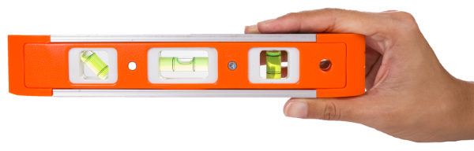
Mission 11: Reaction Time
How level is your desk or table?
Write some code to find out. During
this project you will build a spirit level.
Project Goals:
Display a numeric "tilt" value from the accelerometer.
Scale the raw tilt value to show 0° to 90° incline.
Replace the number display with a graphical ball simulation!

Slide 4

Objective #1: Accel
This mission will use CodeX’s built-in accelerometer
What is an accelerometer?
Click on
Go to the Mission Log and answer the question.
Return to the digital instructions.
Go back to the Mission Log and answer the question.

Slide 5
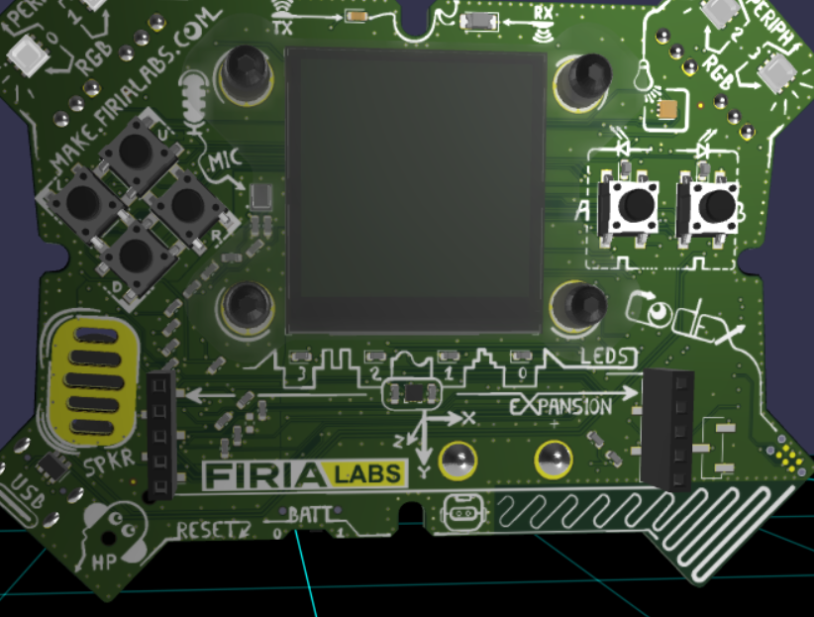
Mission Activity #1
DO THIS:
Close the instruction panel
Use the camera controls to zoom in
Click on the accelerometer
Create a new file named Spirit_Level

Slide 6

Objective #2: Tilt-o-Matic
When you read the accelerometer, it returns three values, one for each axis.
The three values are enclosed in parenthesis: (x, y, z)
This type of data is called a tuple.
Other tuples:
  Color values: (red, green, blue)
  Location on a grid: (x, y)

Slide 7
Objective #2: Tilt-o-Matic
To read the accelerometer, use this code:
val = accel.read()
A tuple is a special kind of list. You can get
specific x, y or z values like items in a list:
tilt_x = val[0] # first value is at index 0
tilt_y = val[1]
tilt_z = val[2]

Slide 8
Objective #2: Tilt-o-Matic
This mission will use CodeX’s built-in accelerometer
Go to the Mission Log and answer the questions about data from the accelerometer.

Slide 9
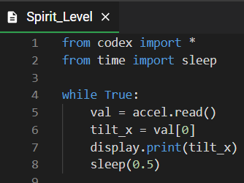
Mission Activity #2
DO THIS:
Read the accelerometer
Display the x value
Delay a short time to read the display
Your code could look like this:

Slide 10
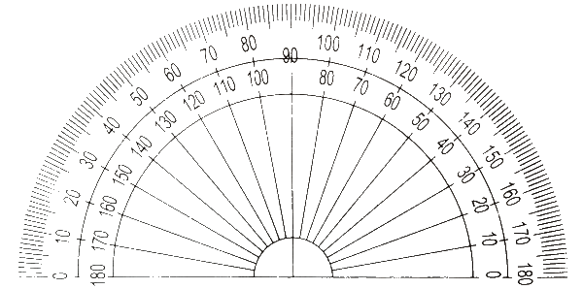
Objective #3: Scale to Degrees
The numbers you see on the display are all over the place.
We usually measure angles in degrees.
You need to convert the raw data -- numbers you see on the display -- into degrees.
This involves some complicated math -- trigonometry -- so use the code given and don’t worry about the actual math

Slide 11
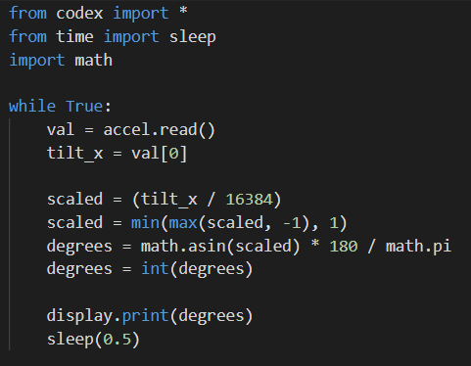
Mission Activity #3
DO THIS:
Import the math module
Add the code as shown
Change the display.print to show degrees
Run the code
  Can you get CodeX level,
  with 0 degrees?
Go to the Mission Log and answer the question

Slide 12
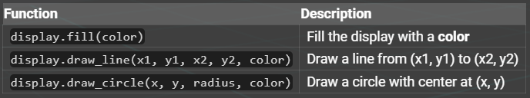
Objective #4: Static Ball
Time to learn a little about drawing on the display
Here are the drawing functions you will use for your spirit level:

Slide 13
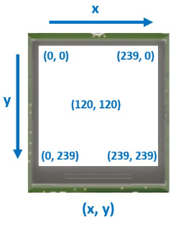
Objective #4: Static Ball
Concept: The display
The CodeX LCD display is
240 pixels x 240 pixels
Each tiny pixel works JUST like the 4 RGB LED pixels at the top of the CodeX.
x in the (x, y) is the display width
y is the display height

Slide 14
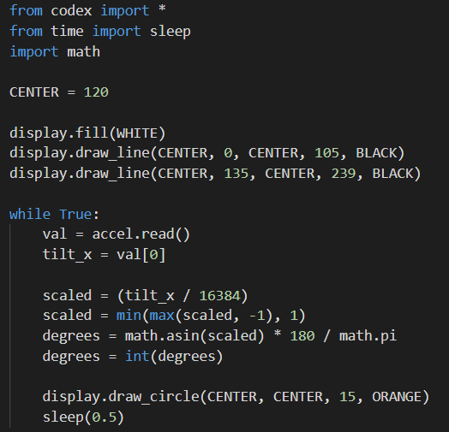
Mission Activity #4
DO THIS:
Define a value for the center of the display
Type the code to draw a line in the center
Change the display.print to drawing a circle instead

Slide 15
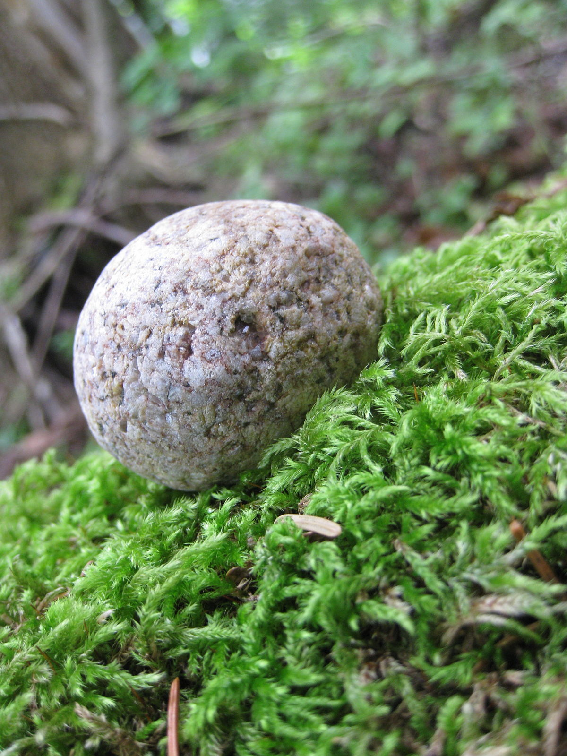
Objective #5: Rolling Stone
Time to make that ball move
Use the information you have:
  Center of display
  Degrees for x
Use math to calculate the position of the circle
Use a variable for the data

Slide 16
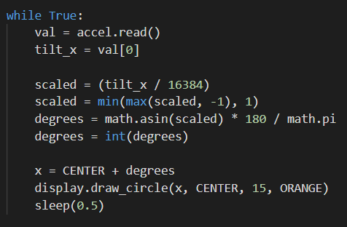
Mission Activity #5
DO THIS:
Define a value for the x position
Assign it the value:
  x = CENTER + degrees
Use the variable in the draw_circle() command
Run the code and tilt CodeX to see the ball move

Slide 17

Accelisplay
During this mission you have learned about the accelerometer and the display.
Answer 3 quiz questions about the concepts.
CODEX
QUIZ

Slide 18

Objective #6: Eraser First
Spirit Level -- final touches
Why is the ball drawing on top of itself?
Because you are not erasing it first.
Cover your tracks!
Draw a white circle to “erase” the current circle before moving to a new position and drawing a new orange circle.

Slide 19
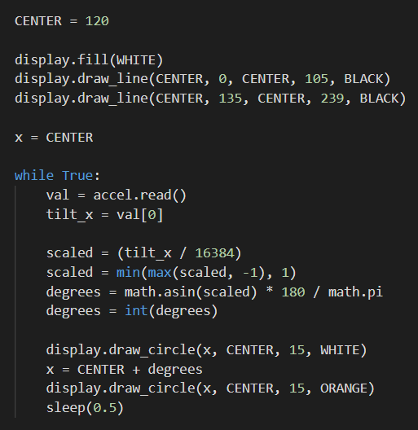
Mission Activity #6
DO THIS:
Define the x variable above the while loop
Draw a white circle before calculating a new x value
Run your program
Does it work correctly?

Slide 20
Post-Mission Reflection
Read the “completed mission” message and click to complete the mission
Complete the Mission 11 Log

Slide 21
Clearing your CodeX
Go to FILE -- BROWSE FILES
Select the “Clear” file and open it
Run the program to clear the CodeX

